Slide 1

PRESENTED BY: Neenu Manuval MCA S6 No:36

Slide 2
Abstract
Sathyadeepam is a Malayalam catholic weekly
published from Ernakulam, Kochi in Kerala. The
weekly is a source for the official stance of the
Kerala Catholic Church in general and the
Syro Malabar Church in particular.

Slide 3
Modules
Super Admin
publisher
Registered user
Guest User

Slide 4
Super Admin
Add,Delete Edit the user and publisher
Editing Capability
Giving roles for user
Rate details
Contact detais

Slide 5
Publisher
Publish Editorals,novel,poems... etc
View Reader’s comment
Upload news

Slide 6
Registered user
Sign_up
Sign_in
Update profile
Subscription
Billing details
Make payment

Slide 7
Guest User
view the public items
post their comments
Send contact details

Slide 8
Technology hierarchy
Front End:
HTML
CSS
Java Script
Twitter Bootstrap
Back-End
MySQL
PHP
WordPress

Slide 9
Introduction to PHP
PHP is a server-side scripting language designed for web development but also used as a general-purpose programming language. PHP code is usually processed by a PHP interpreter, which is usually implemented as a web server's native module or a Common Gateway Interface (CGI) executable. After the PHP code is interpreted and executed, the web server sends resulting output to its client, usually in form of a part of the generated webpage; for example, PHP code can generate a web page's HTML code, an image, or some other data. PHP has also evolved to include a command-line interface (CLI) capability and can be used in standalone graphical applications.

Slide 10
NETBEANS
Netbeans is an integrated development environment (IDE) for developing primarily with Java, but also with other languages, in particular PHP, C/C++, and HTML5.It is also an application platform framework for Java desktop applications and others. The NetBeans IDE is written in Java and can run on Windows, OS X, Linux, Solaris and other platforms supporting a compatible JVM. The Net Beans Platform allows applications to be developed from a set of modular software components called modules
Among the features of the platform are:
User interface management (e.g. menus and toolbars)
User settings management
Storage management (saving and loading any kind of data)
Window management

Slide 11
WORDPRESS
WordPress is an open source Content Management System (CMS), which allows the
users to build dynamic websites and blogs. WordPress is the most popular blogging
system on the web and allows updating, customizing and managing the website from
its back-end CMS and components.
WordPress is an Content Management System (CMS), which is open source and was
created to manage blogs. WordPress allows you to easily create and manage your
blogs and websites content without coding and it can be used to create fully
operational website.
The Content Management System (CMS) is a software which stores all the data such
as text, photos, music, documents, etc. and is made available on your website. It
helps in editing, publishing and modifying the content of the website

Slide 12
Characteristics
The most important features of WordPress are that you can create dynamic website without any programming and designing knowledge.
WordPress is theme based which provides you options of various open source and premium design themes, which can be integrate easily without any designing knowledge.
Plugins extends the functionality of WordPress, which can be used to add new required modules.
WordPress sites are search engine optimization (SEO) friendly, it means sites built in WordPress can be easily optimized for search engine listings.
WordPress is Multilingual, which allow users to translating content in their language.
WordPress has inbuilt Media Management System which is used to manage images, music, documents etc. and can be used with text content.

Slide 13
My SQL
Structured Query Language (SQL), in computer science, a database sub
language used in querying, updating and managing relational databases.
Derived from an IBM research project that created Structured English Query
Language (SEQUEL) in the 1970’s SQL is accepted standard in database
products. Although it is not a programming language in the same sense as
C or PASCAL, SQL can either be used in formulating interactive queries or
be embedded in as application as for handling data.
Microsoft SQL server is a relational database that runs on the Windows NT
operating system. SQL (RDBMS) is a widely accepted industry standard for defining ,
changing and managing data and controlling how changes to the database are made
by using tables, index keys rows and columns to store data.

Slide 14
Features
A variety of user interfaces
Physical data independence
Logical data independence
Query optimization
Data integrity
Concurrency control
Backup and recovery
Security and authorization

Slide 15
System specification
Hardware specification
Processors : Intel Premium Pro or Processor running at 133 MHz
Hard Disk : 1.2 GB Hard Disk
RAM : Client Level – Minimum 128MB
Recommended Requirements for peak performance
RAM : Client Level – Minimum 512MB
Display Type : SVGA Colour Enhanced Monitor
Mouse : PS/2 2 Button

Slide 16
Software specification
Front End Tool : HTML, JavaScript, CSS, Twitter Bootstrap
Back End Tool : PHP, WordPress, MySQL
Operating System : Windows XP 7 Professionals and Higher
Browser : Google Chrome, Mozilla Firefox

Slide 17
Table Design
Tbl_Login
Field | Type | Description
id | int | Login id
usernamr | varchar | username
password | varchar | Password of the user

Slide 18
Tbl_user
Field | Type | Description
uid | Int | User id
Name | Varchar | Nameof the user
Adress | Varchar | Dress of the user
User_email | Varchar | Emal address
Username | Varchar | username
password | Varchar | password

Slide 19
Tbl_post
Field | Type | Descripton
pid | int | Post id
Post_type | varchar | Type of the post
Post_author | varchar | Author of the post
Podt_date | date | Date and time of the post
Post_title | varchar | Title of the post
Post_content | varchar | Content of the post
Status

Slide 20
Tbl_comment
Field | Type | Description
Com_id | int | Comment id
Com_post_id | int | Post id
Com_author | Varchar | Person who write comment
Com_email | Varchar | Email addess
Com_date | Date time | Date and tme of comment

Slide 21
Tbl_postviews
Field | Type | Description
View_id | int | Postview id
pid | int | Post id
period | varchar | Period of the post

Slide 22
Tbl_category
Field | Type | Description
Cat_id | int | Category id
Name | varchar | Category name

Slide 23
Tbl-Product
Field | Data type | Descrption
pid | int | Product id
cid | int | Category id
Pro_name | varachar | Product name
Pro_type | varchar | Product type
Pro_rate | vaarhar | Product rate

Slide 24
Tbl_orderproduct
Field | Datatype | Description
dw_id | int | Download id
P_id | int | Product id
User_email | varchar | Emai address
U_id | int | User id
Access_granted | datetme | Access grnted
acess_expir | datetime | Access expires

Slide 25
Tbl_cart
Field | type | Description
Cart_id | Int | Cart id
P_id | Int | Product id
Quantity | Varchar | Quantity
total | varchar | Total amount

Slide 26
Tbl_billing
Field | Type | Description
B_id | Int | Billing id
F_name | Varchar | First name
L_name | Varchar | Last name
Country | Varchar | Country
Address | Varchar | Address details
Town | Varchar | Town or city
State | Varchar | State selection
Zip | Varchar | Zip or pincode
Phn | Int | Phone number
Email | Varchar | Email address
Acc_no | varchar | Account number

Slide 27
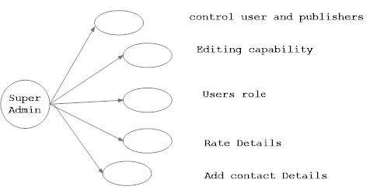
UML

Slide 28
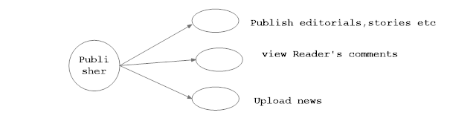
UML(cont...)

Slide 29
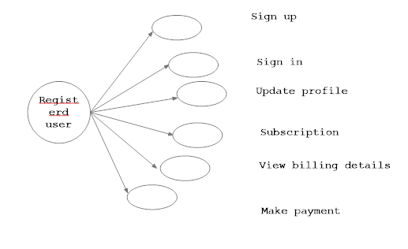
UML(cont...)

Slide 30
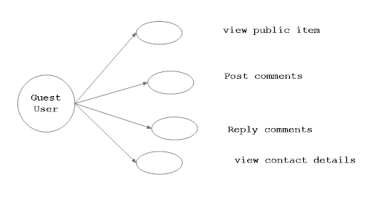
UML(cont...)

Slide 31
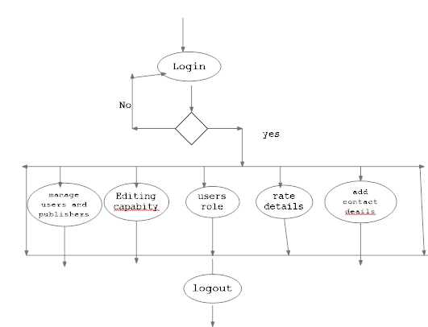
Activity Diagram

Slide 32
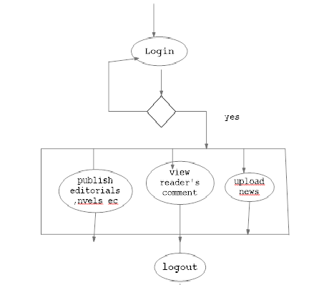
Publisher

Slide 33
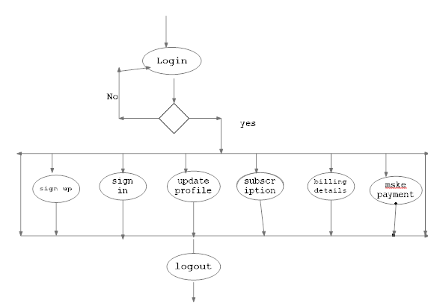
Registered user

Slide 34
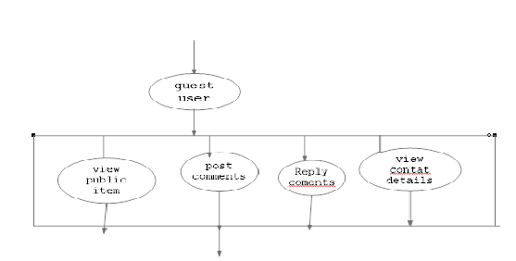
Guest user

Slide 35
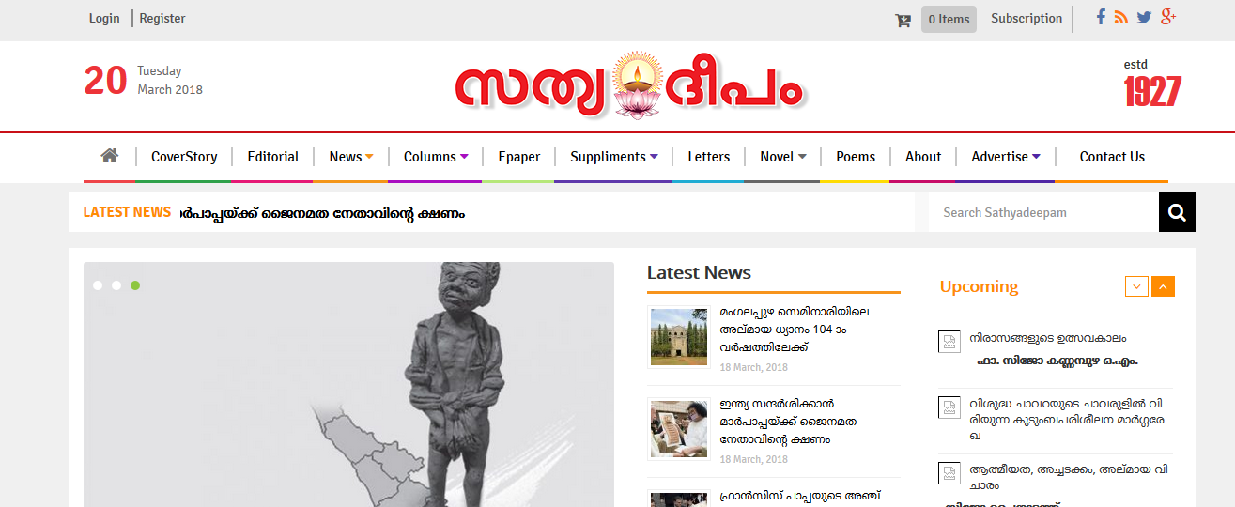
Home page

Slide 36
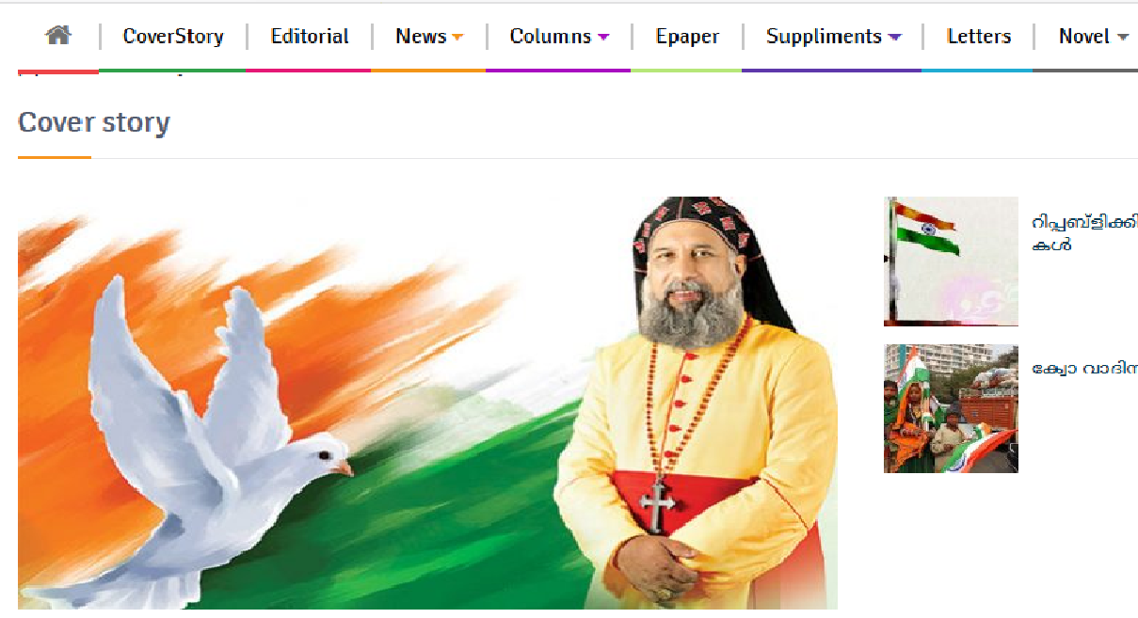
Coverstory

Slide 37
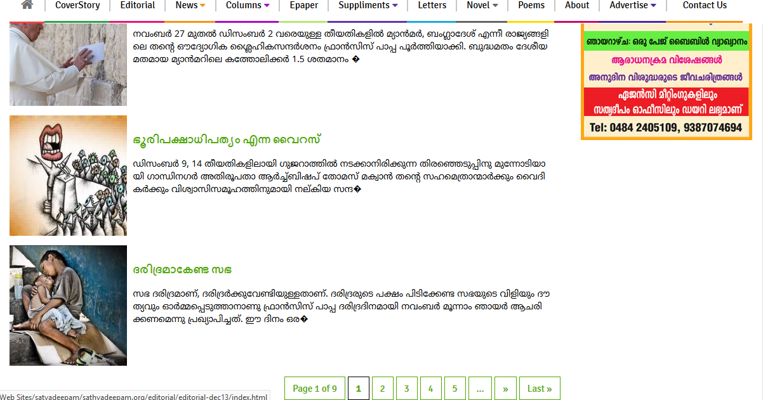
Editorial

Slide 38
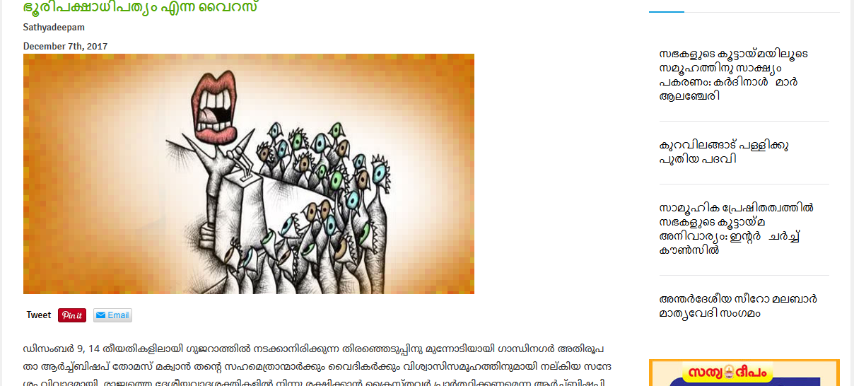
Editorial....

Slide 39
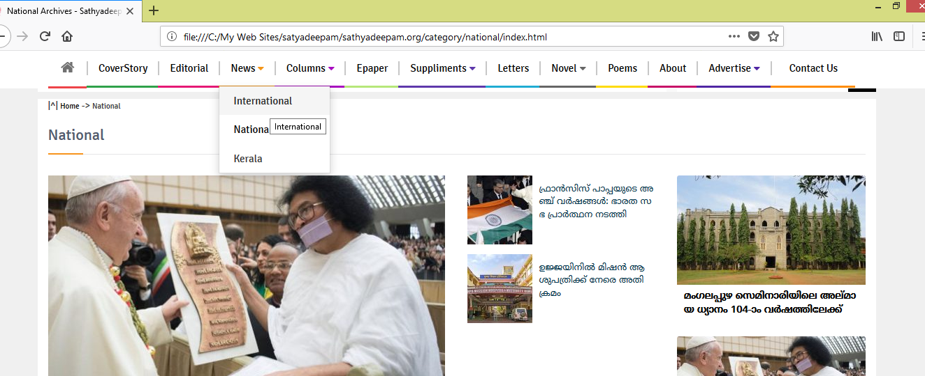
News

Slide 40
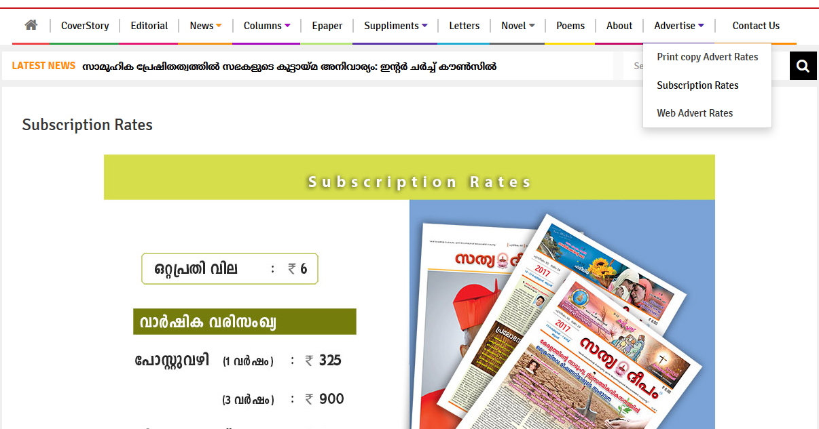
Advertise

Slide 41
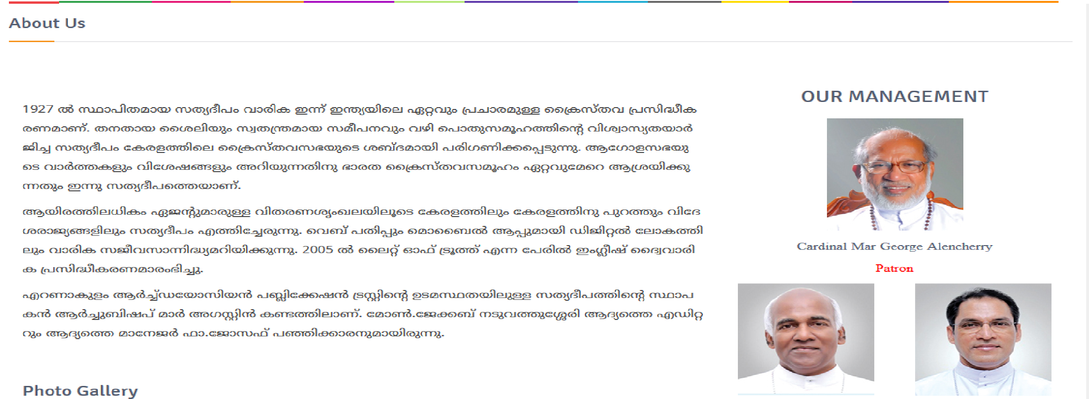
About

Slide 42
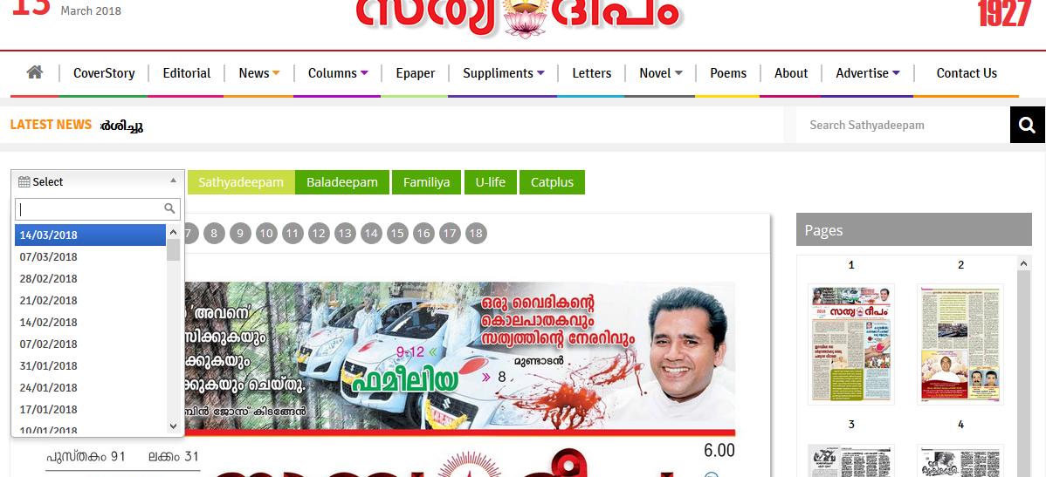
E-paper

Slide 43
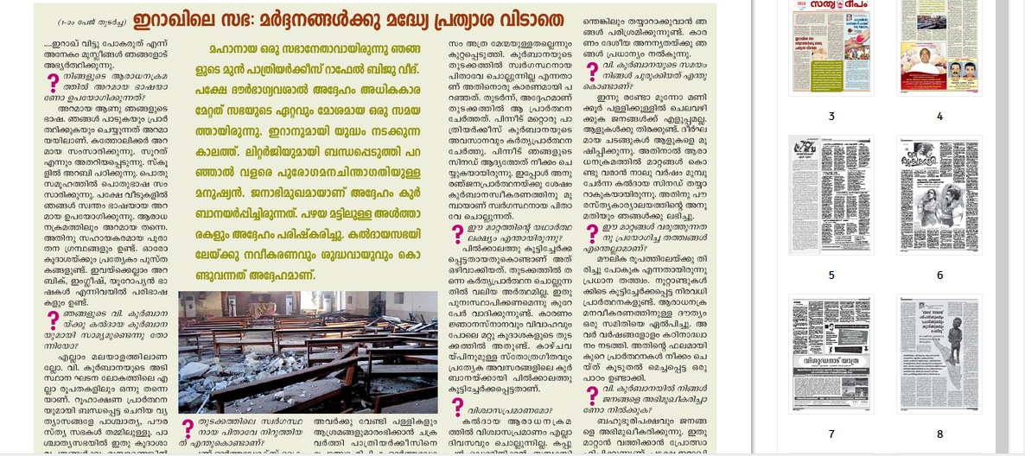
Epaper

Slide 44
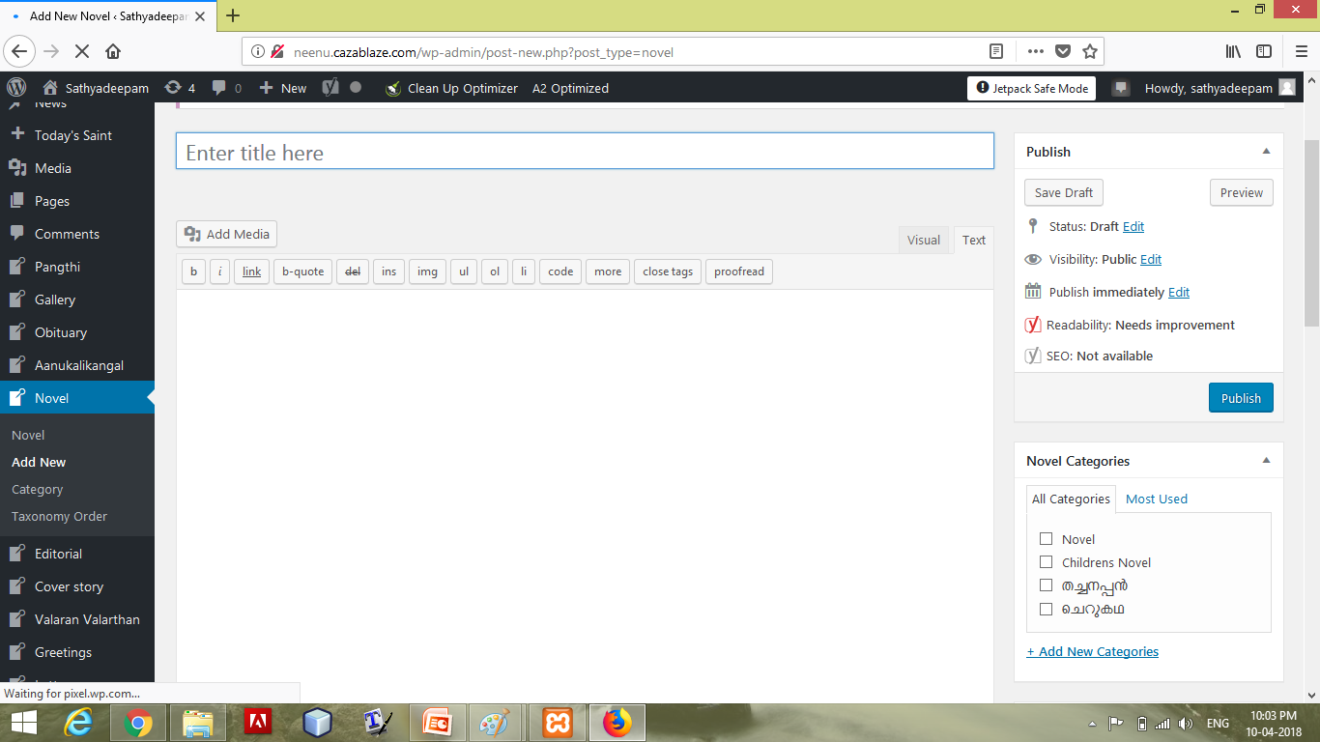
Add contents

Slide 45
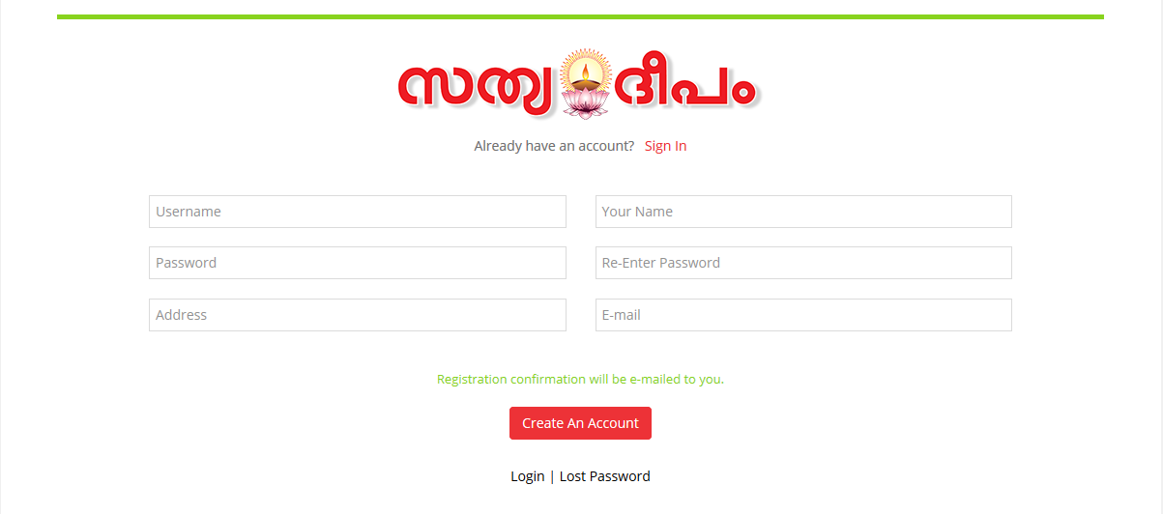
Register

Slide 46
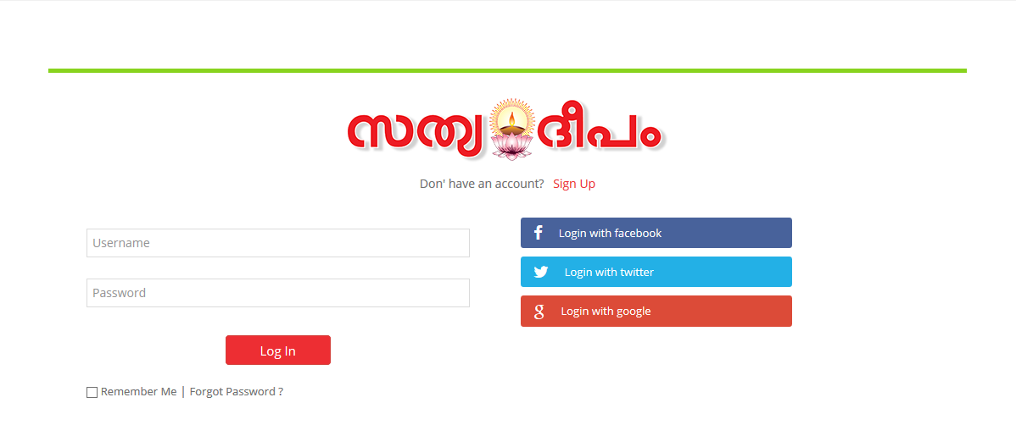
Log in

Slide 47
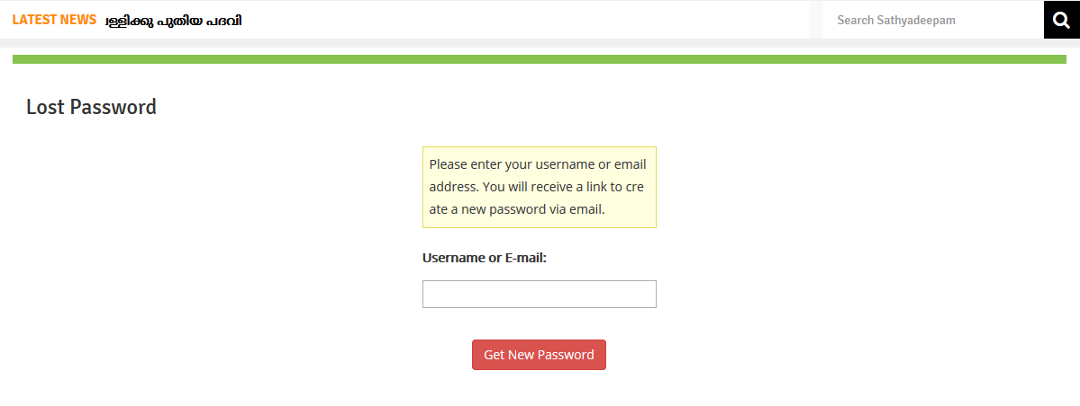
Forgot password

Slide 48
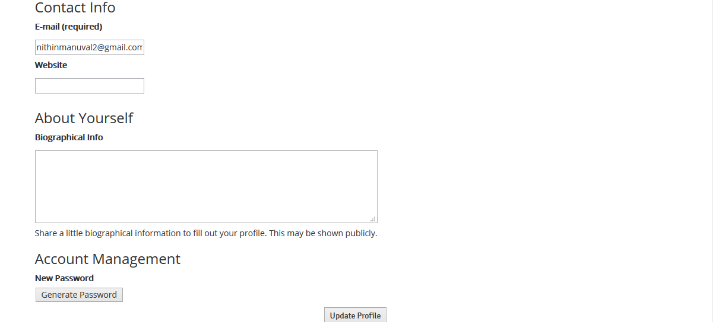
User profile

Slide 49
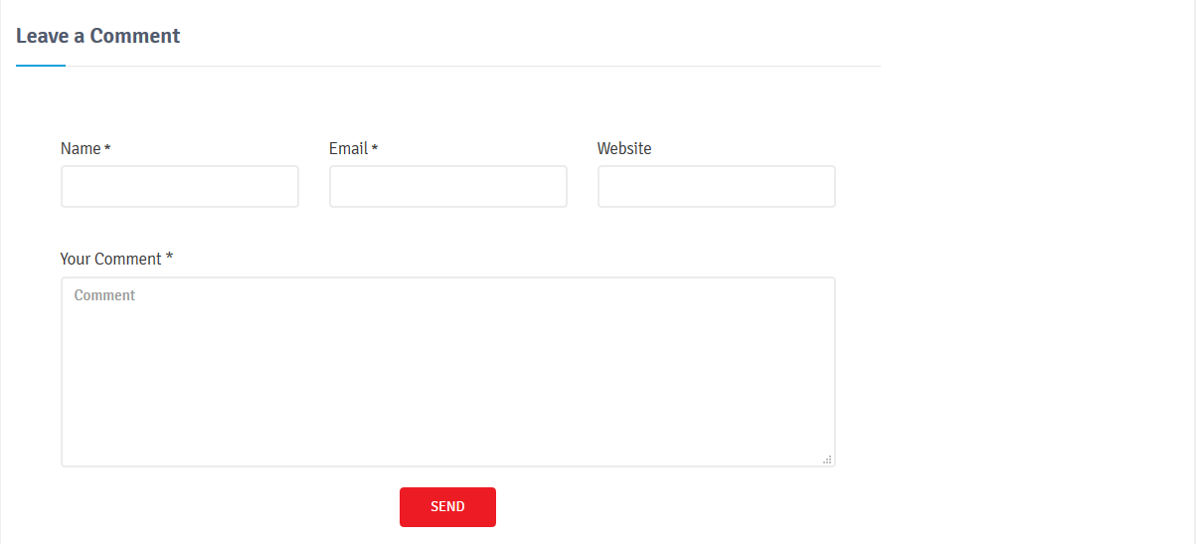
Comment

Slide 50
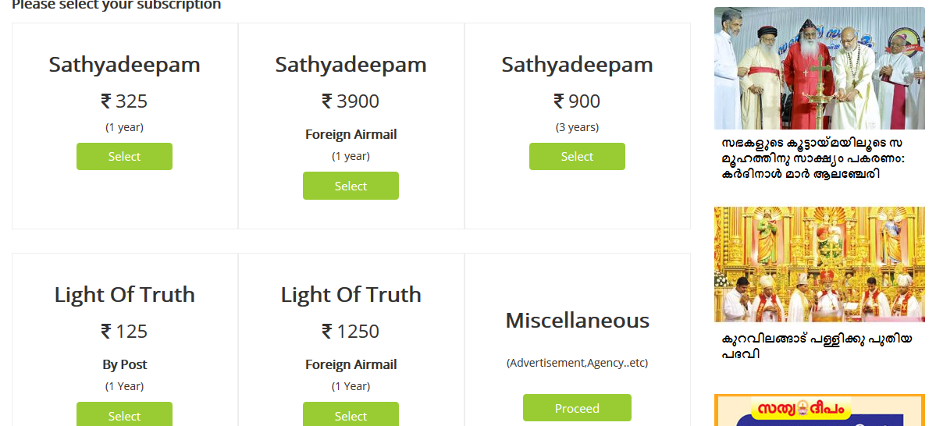
product

Slide 51
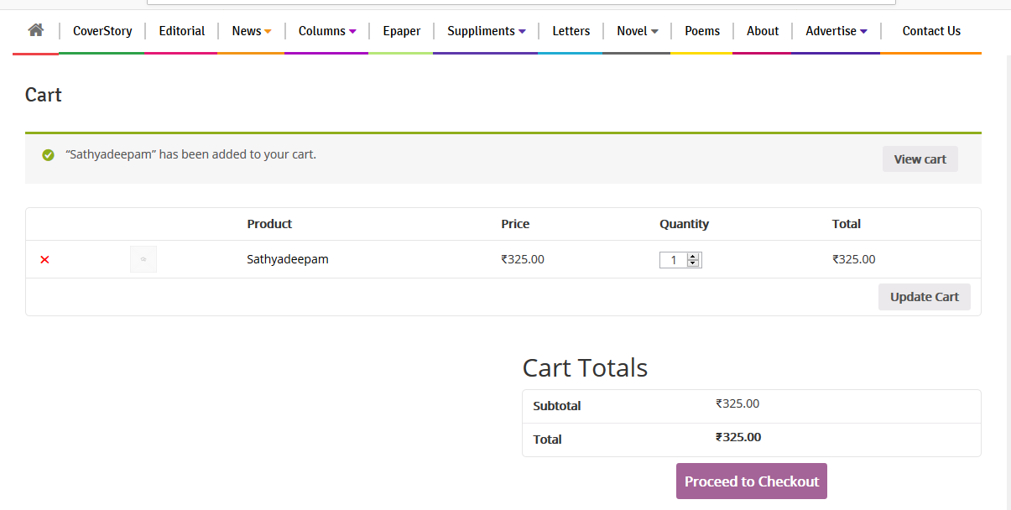
Cart

Slide 52
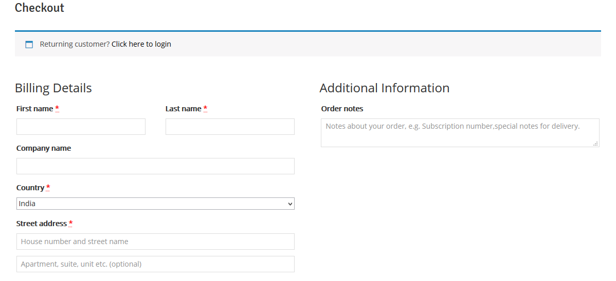
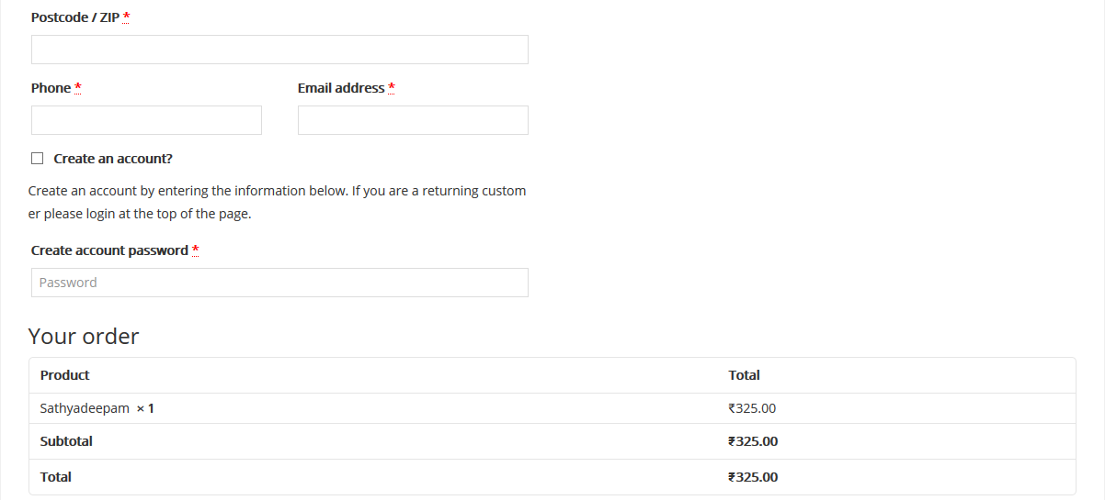
Billing

Slide 53
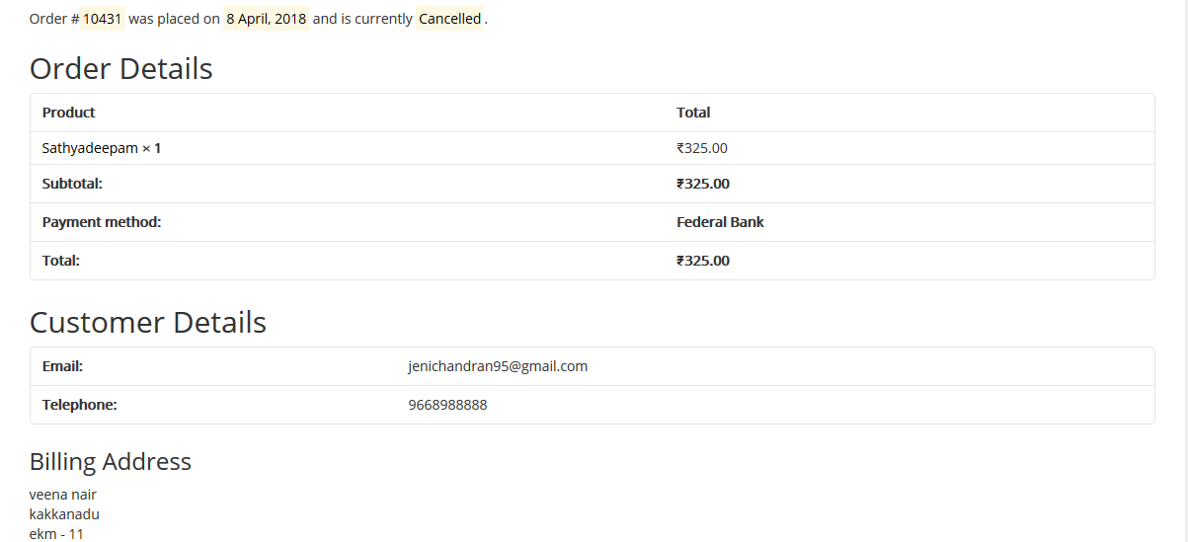
Order Details

Slide 54
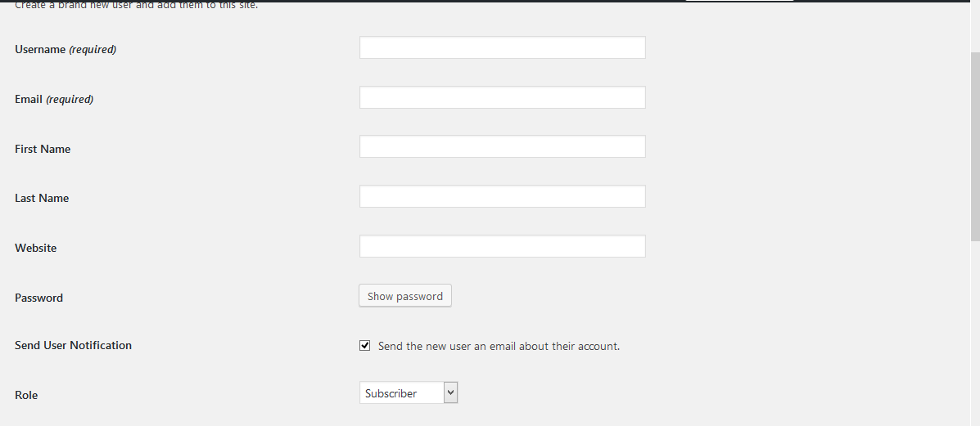
Role assigning

Slide 55
Thank you..!

